Slide 2
Scoring, Term Weighting, and Vector Space Model

Slide 3
Binary incidence matrix
 | Anthony and Cleopatra | Julius Caesar | The Tempest | Hamlet | Othello | Macbeth . . .
ANTHONY BRUTUS CAESAR CALPURNIA CLEOPATRA MERCY WORSER . . . | 1 1 1 0 1 1 1 | 1 1 1 1 0 0 0 | 0 0 0 0 0 1 1 | 0 1 1 0 0 1 1 | 0 0 1 0 0 1 1 | 1 0 1 0 0 1 0
Each document is represented as a binary vector ∈ {0, 1}^{|V|.}
3

Slide 4
Binary incidence matrix
 | Anthony and Cleopatra | Julius Caesar | The Tempest | Hamlet | Othello | Macbeth . . .
ANTHONY BRUTUS CAESAR CALPURNIA CLEOPATRA MERCY WORSER . . . | 157 4 232 0 57 2 2 | 73 157 227 10 0 0 0 | 0 0 0 0 0 3 1 | 0 2 2 0 0 8 1 | 0 0 1 0 0 5 1 | 1 0 0 0 0 8 5
Each document is now represented as a count vector ∈ N^{|V|.}
4

Slide 5
Bag of words model
  We do not consider the order of words in a document.
  John is quicker than Mary and Mary is quicker than John are represented the same way.
  This is called a bag of words model.
  In a sense, this is a step back: The positional index was able to distinguish these two documents.
  We will look at “recovering” positional information later in this course.
  For now: bag of words model
5

Slide 6
Term frequency tf
  The term frequency tf_{t,d} of term t in document d is defined as the number of times that t occurs in d.
  We want to use tf when computing query-document match scores.
  But how?
  Raw term frequency is not what we want because:
  A document with tf = 10 occurrences of the term is more relevant than a document with tf = 1 occurrence of the term.
  But not 10 times more relevant.
  Relevance does not increase proportionally with term frequency.
6

Slide 7

Instead of raw frequency: Log frequency weighting
  The log frequency weight of term t in d is defined as follows
  tf_{t,d} → w_{t,d} : 0 → 0, 1 → 1, 2 → 1.3, 10 → 2, 1000 → 4, etc.
  Score for a document-query pair: sum over terms t in both q and d: tf-matching-score(q, d) = _{t∈q∩d} (1 + log tf_{t,d} )
  The score is 0 if none of the query terms is present in the document.
7

Slide 8
Frequency in document vs. frequency in collection
  In addition, to term frequency (the frequency of the term in the document) . . .
  . . .we also want to use the frequency of the term in the collection for weighting and ranking.
8

Slide 9
Desired weight for rare terms
  Rare terms are more informative than frequent terms.
  Consider a term in the query that is rare in the collection (e.g., ARACHNOCENTRIC).
  A document containing this term is very likely to be relevant.
  → We want high weights for rare terms like ARACHNOCENTRIC.
9

Slide 10
Desired weight for frequent terms
  Frequent terms are less informative than rare terms.
  Consider a term in the query that is frequent in the collection (e.g., GOOD, INCREASE, LINE).
  A document containing this term is more likely to be relevant than a document that doesn’t . . .
  . . . but words like GOOD, INCREASE and LINE are not sure indicators of relevance.
  → For frequent terms like GOOD, INCREASE and LINE, we want positive weights . . .
  . . . but lower weights than for rare terms.
10

Slide 11
Document frequency
  We want high weights for rare terms like ARACHNOCENTRIC.
  We want low (positive) weights for frequent words like GOOD, INCREASE and LINE.
  We will use document frequency to factor this into computing the matching score.
  The document frequency is the number of documents in the collection that the term occurs in.
11

Slide 12

idf weight
  df_{t} is the document frequency, the number of documents that t occurs in.
  df_{t} is an inverse measure of the informativeness of term t.
  We define the idf weight of term t as follows:
  (N is the number of documents in the collection.)
  idf_{t} is a measure of the informativeness of the term.
  [log N/df_{t} ] instead of [N/df_{t} ] to “dampen” the effect of idf
  Note that we use the log transformation for both term frequency and document frequency.
12

Slide 13

Examples for idf
  Compute idf_{t} using the formula:
term | df_{t} | idf_{t}
calpurnia animal sunday fly under the | 1 100 1000 10,000 100,000 1,000,000 | 6 4 3 2 1 0
13

Slide 14
Effect of idf on ranking
  idf affects the ranking of documents for queries with at least two terms.
  For example, in the query “arachnocentric line”, idf weighting increases the relative weight of ARACHNOCENTRIC and decreases the relative weight of LINE.
  idf has little effect on ranking for one-term queries.
14

Slide 15
Collection frequency vs. Document frequency
word | collection frequency | document frequency
INSURANCE TRY | 10440 10422 | 3997 8760
  Collection frequency of t: number of tokens of t in the collection
  Document frequency of t: number of documents t occurs in
  Why these numbers?
  Which word is a better search term (and should get a higher weight)?
  This example suggests that df (and idf) is better for weighting than cf (and “icf”).
15

Slide 16

tf-idf weighting
  The tf-idf weight of a term is the product of its tf weight and its idf weight.
  tf-weight
  idf-weight
  Best known weighting scheme in information retrieval
  Note: the “-” in tf-idf is a hyphen, not a minus sign!
  Alternative names: tf.idf, tf x idf
16

Slide 17

Summary: tf-idf
  Assign a tf-idf weight for each term t in each document d:
  The tf-idf weight . . .
    . . . increases with the number of occurrences within a document. (term frequency)
    . . . increases with the rarity of the term in the collection. (inverse document frequency)
17

Slide 18
Outline
Recap
Why ranked retrieval?
Term frequency
tf-idf weighting
The vector space model

Slide 19
Binary incidence matrix
 | Anthony and Cleopatra | Julius Caesar | The Tempest | Hamlet | Othello | Macbeth . . .
ANTHONY BRUTUS CAESAR CALPURNIA CLEOPATRA MERCY WORSER . . . | 1 1 1 0 1 1 1 | 1 1 1 1 0 0 0 | 0 0 0 0 0 1 1 | 0 1 1 0 0 1 1 | 0 0 1 0 0 1 1 | 1 0 1 0 0 1 0
Each document is represented as a binary vector ∈ {0, 1}^{|V|.}
19

Slide 20
Count matrix
 | Anthony and Cleopatra | Julius Caesar | The Tempest | Hamlet | Othello | Macbeth . . .
ANTHONY BRUTUS CAESAR CALPURNIA CLEOPATRA MERCY WORSER . . . | 157 4 232 0 57 2 2 | 73 157 227 10 0 0 0 | 0 0 0 0 0 3 1 | 0 2 2 0 0 8 1 | 0 0 1 0 0 5 1 | 1 0 0 0 0 8 5
Each document is now represented as a count vector ∈ N^{|V|.}
20

Slide 21
Binary → count → weight matrix
 | Anthony and Cleopatra | Julius Caesar | The Tempest | Hamlet | Othello | Macbeth . . .
ANTHONY BRUTUS CAESAR CALPURNIA CLEOPATRA MERCY WORSER . . . | 5.25 1.21 8.59 0.0 2.85 1.51 1.37 | 3.18 6.10 2.54 1.54 0.0 0.0 0.0 | 0.0 0.0 0.0 0.0 0.0 1.90 0.11 | 0.0 1.0 1.51 0.0 0.0 0.12 4.15 | 0.0 0.0 0.25 0.0 0.0 5.25 0.25 | 0.35 0.0 0.0 0.0 0.0 0.88 1.95
Each document is now represented as a real-valued vector of tfidf weights ∈ R^{|V|.}
21

Slide 22
Documents as vectors
  Each document is now represented as a real-valued vector of tf-idf weights ∈ R^{|V|.}
  So we have a |V|-dimensional real-valued vector space.
  Terms are axes of the space.
  Documents are points or vectors in this space.
  Very high-dimensional: tens of millions of dimensions when you apply this to web search engines
  Each vector is very sparse - most entries are zero.
22

Slide 23
Queries as vectors
  Key idea 1: do the same for queries: represent them as vectors in the high-dimensional space
  Key idea 2: Rank documents according to their proximity to the query
  proximity = similarity
  proximity ≈ negative distance
  Recall: We’re doing this because we want to get away from the you’re-either-in-or-out, feast-or-famine Boolean model.
  Instead: rank relevant documents higher than nonrelevant documents
23

Slide 24
How do we formalize vector space similarity?
  First cut: (negative) distance between two points
  ( = distance between the end points of the two vectors)
  Euclidean distance?
  Euclidean distance is a bad idea . . .
  . . . because Euclidean distance is large for vectors of different lengths.
24

Slide 25
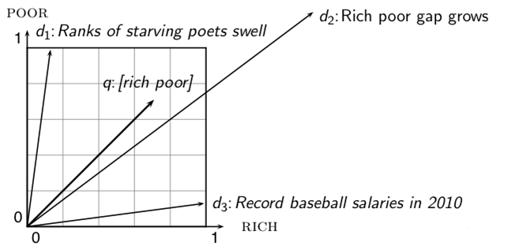
Why distance is a bad idea
The Euclidean distance of and is large although the distribution of terms in the query q
and the distribution of terms in the document d₂ are very similar.
Questions about basic vector space setup?
25

Slide 26
Use angle instead of distance
  Rank documents according to angle with query
  Thought experiment: take a document d and append it to itself. Call this document d′. d′ is twice as long as d.
  “Semantically” d and d′ have the same content.
  The angle between the two documents is 0, corresponding to maximal similarity . . .
  . . . even though the Euclidean distance between the two documents can be quite large.
26

Slide 27
From angles to cosines
  The following two notions are equivalent.
    Rank documents according to the angle between query and document in decreasing order
    Rank documents according to cosine(query,document) in increasing order
  Cosine is a monotonically decreasing function of the angle for the interval [0◦, 180◦]
27

Slide 28
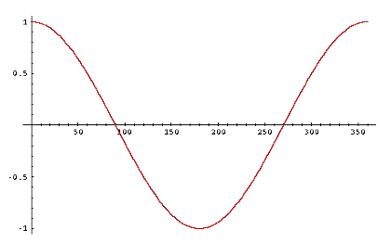
Cosine
28

Slide 29


Length normalization
  How do we compute the cosine?
  A vector can be (length-) normalized by dividing each of its components by its length – here we use the L₂ norm:
  This maps vectors onto the unit sphere . . .
  . . . since after normalization:
  As a result, longer documents and shorter documents have weights of the same order of magnitude.
  Effect on the two documents d and d′ (d appended to itself) from earlier slide: they have identical vectors after length-normalization.
29

Slide 30

Cosine similarity between query and document
  q_{i} is the tf-idf weight of term i in the query.
  d_{i} is the tf-idf weight of term i in the document.
  This is the cosine similarity of and . . . . . . or, equivalently, the cosine of the angle between and
30

Slide 31

Cosine for normalized vectors
  For normalized vectors, the cosine is equivalent to the dot product or scalar product.
    (if and are length-normalized).
31

Slide 32
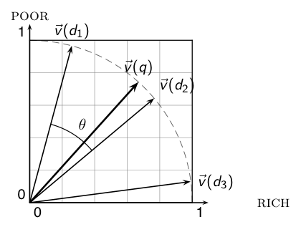
Cosine similarity illustrated
32

Slide 33
Cosine: Example
term frequencies (counts)
  How similar are
  these novels? SaS:
  Sense and
  Sensibility PaP:
  Pride and
  Prejudice WH:
  Wuthering
  Heights
term | SaS | PaP | WH
AFFECTION JEALOUS GOSSIP WUTHERING | 115 10 2 0 | 58 7 0 0 | 20 11 6 38
33

Slide 34
Cosine: Example
term frequencies (counts) log frequency weighting
(To simplify this example, we don't do idf weighting.)
term | SaS | PaP | WH
AFFECTION JEALOUS GOSSIP WUTHERING | 115 10 2 0 | 58 7 0 0 | 20 11 6 38
term | SaS | PaP | WH
AFFECTION JEALOUS GOSSIP WUTHERING | 3.06 2.0 1.30 0 | 2.76 1.85 0 0 | 2.30 2.04 1.78 2.58
34

Slide 35
Cosine: Example
log frequency weighting log frequency weighting &
cosine normalization
term | SaS | PaP | WH
AFFECTION JEALOUS GOSSIP WUTHERING | 3.06 2.0 1.30 0 | 2.76 1.85 0 0 | 2.30 2.04 1.78 2.58
term | SaS | PaP | WH
AFFECTION JEALOUS GOSSIP WUTHERING | 0.789 0.515 0.335 0.0 | 0.832 0.555 0.0 0.0 | 0.524 0.465 0.405 0.588
  Normalization example:“AFFECTION“ – 3.06/sqrt(3.06^2+2^2+1.3^2)
  cos(SaS,PaP) ≈ 0.789 ∗ 0.832 + 0.515 ∗ 0.555 + 0.335 ∗ 0.0 + 0.0 ∗ 0.0 ≈ 0.94.
  cos(SaS,WH) ≈ 0.79
  cos(PaP,WH) ≈ 0.69
  Why do we have cos(SaS,PaP) > cos(SAS,WH)?
35

Slide 36
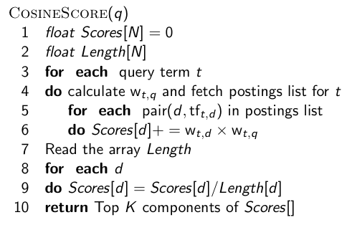
Computing the cosine score
36

Slide 37
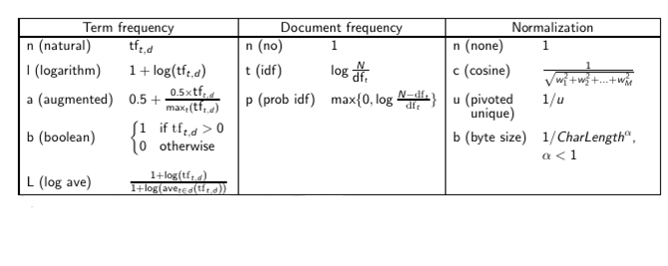
Components of tf-idf weighting
37

Slide 38
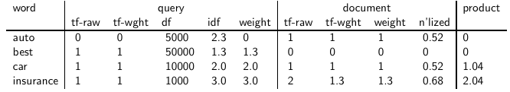
tf-idf example:
  Query: “best car insurance”. Document: “car insurance auto insurance”.
Key to columns: tf-raw: raw (unweighted) term frequency, tf-wght: logarithmically weighted term frequency, df: document frequency, idf: inverse document frequency, weight: the final weight of the term in the query or document, n’lized: document weights after cosine normalization, product: the product of final query weight and final document weight
1/1.92 ≈ 0.52
1.3/1.92 ≈ 0.68 Final similarity score between query and
document: _{i} w_{qi} · w_{di} = 0 + 0 + 1.04 + 2.04 = 3.08
38

Slide 39
D1: “new york times”
D2: “new york post”
D3: “los angeles times”
1. Count raw tf
 | angeles | los | new | post | times | york
D1 | 0 | 0 | 1 | 0 | 1 | 1
D2 | 0 | 0 | 1 | 1 | 0 | 1
D3 | 1 | 1 | 0 | 0 | 1 | 0
df | 1 | 1 | 2 | 1 | 2 | 2
1. Calculate weighted tf = 1+log(raw_tf)
 | angeles | los | new | post | times | york
D1 | 0 | 0 | 1 | 0 | 1 | 1
D2 | 0 | 0 | 1 | 1 | 0 | 1
D3 | 1 | 1 | 0 | 0 | 1 | 0

Slide 40
3. Calculate IDF=log(N/df)
N=3
angeles | Log3=0.477
los | Log3
new | Log1.5=0.176
post | Log3
times | Log1.5
york | Log1.5
4. Calculate tf-idf=tf*idf=(1+log(raw_tf))*log(N/df)
 | angeles | los | new | post | times | york
D1 | 0 | 0 | 0.176 | 0 | 0.176 | 0.176
D2 | 0 | 0 | 0.176 | 0.477 | 0 | 0.176
D3 | 0.477 | 0.477 | 0 | 0 | 0.176 | 0

Slide 41
5. Calculate cosine similarity
Cosine(D1,D2)=(0.176*0.176+0.176*0.176)/(sqrt(0.176^2*3)*sqrt(0.176^2*2+0.477^2))
Cosine similarity | D1 | D2 | D3
D1 | 1
D2 |  | 1
D3 |  |  | 1

Slide 42
Summary: Ranked retrieval in the vector space model
  Represent the query as a weighted tf-idf vector
  Represent each document as a weighted tf-idf vector
  Compute the cosine similarity between the query vector and each document vector
  Rank documents with respect to the query
  Return the top K (e.g., K = 10) to the user
42

Slide 43
Take-away today
  Ranking search results: why it is important (as opposed to just presenting a set of unordered Boolean results)
  Term frequency: This is a key ingredient for ranking.
  Tf-idf ranking: best known traditional ranking scheme
  Vector space model: One of the most important formal models for information retrieval (along with Boolean and probabilistic models)
43

